Slide 1
Autopanner

Slide 2
Manual stereo panner
y_{L} = x cos((p+1)π/4)
y_{R} = x sin((p+1)π/4)
To pan audio, create level difference between left and right channels
To control plugin we modify gain slider we created in tutorial 1
At top of PluginProcessor.cpp change the range and default value of the slider in addParameter
addParameter(pan = new AudioParameterFloat("pan", "Pan", -1.0f, 1.0f, 0.0f));
Change process block in PluginProcessor.cpp to look like this
void DemoProjectAudioProcessor::processBlock (AudioBuffer<float>& buffer, MidiBuffer& midiMessages)
{
auto* channeldataL = buffer.getWritePointer(0);
auto* channeldataR = buffer.getWritePointer(1);
float panVal = pan>get();
for (int i = 0; i < buffer.getNumSamples(); i++) {
auto inputL = channeldataL[i];
auto inputR = channeldataR[i];
inputL = inputL * cos(panVal + 1.0) * PI / 4;
inputR = inputR * sin(panVal + 1.0) * PI / 4;
channeldataL[i] = inputL;
channeldataR[i] = inputR;
}
}

Slide 3
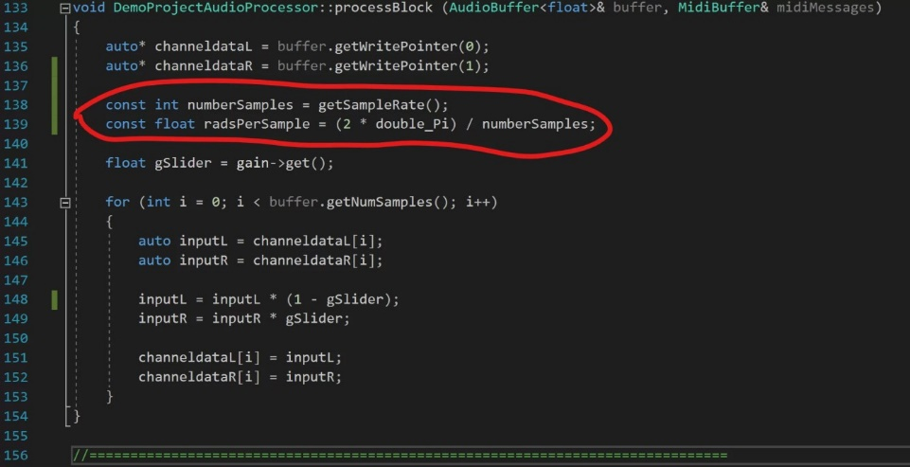
Autopan
Want to modulate pan value over time
Find value of Sin wave at different points, then multiply these values with channel data
First modulate the value between -1 and +1 every LFO period
samples per period = sampleRate / LFOfrequency
48000 samples per second
LFO frequency 10
each sample, increment 2 * 1/4800 or 2 * LFOfrequency / sampleRate
if p > 1 p = p-2. These values multiply each channel of audio instead of the gSlider variable
const int numberSamples = getSampleRate();
const float radsPerSample = (2 * double_Pi) / numberSamples;

Slide 4
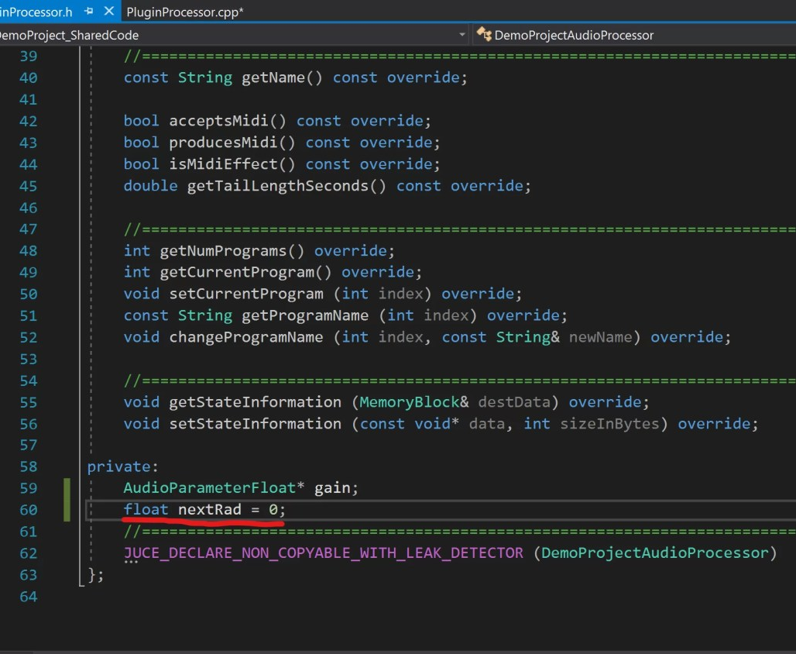
Finds sample rate and how many radians required for each sample length
Use const for these values as they won’t change after each iteration.
Add float to hold value of radians for given sample
don’t want to initialise this every buffer length so add it to header file
Go to PluginProcessor.h and add this in private section
float nextRad = 0;

Slide 5
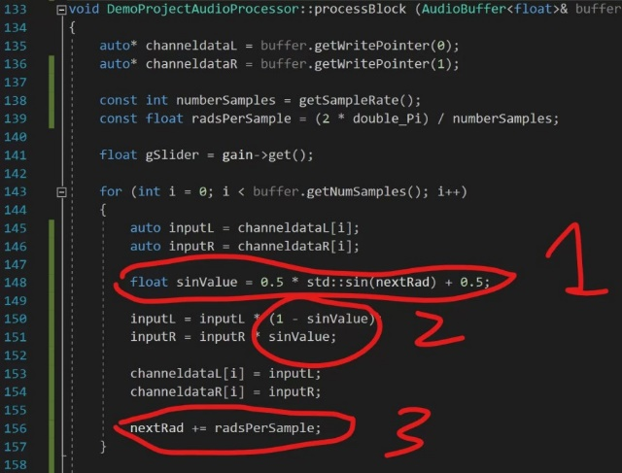
Autopanning
add this to ProcessBlock function in PluginProcessor.cpp
float sinValue = 0.5 * std::sin(nextRad) + 0.5; inputL = inputL * (1 – sinValue); inputR = inputR * sinValue;
nextRad += radsPerSample;
Sets sinValue as Sin at value of nextRad, scaled to 0 to 1
Replaces gSlider with sinValue
Adds radsPerSample to nextRad
Audio pans between left & right channel every second

Slide 6
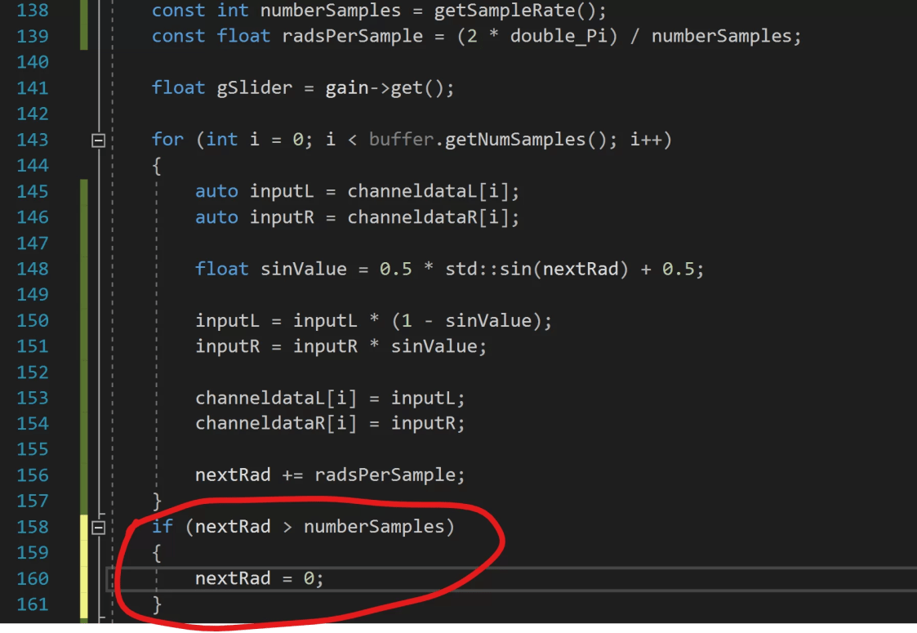
Wrap nextRad variable
nextRad variable will grow forever while the plugin is active
add if statement to bottom of process block
if (nextRad > numberSamples) nextRad = 0;
This resets nextRad after it gets larger than numberSamples

Slide 7
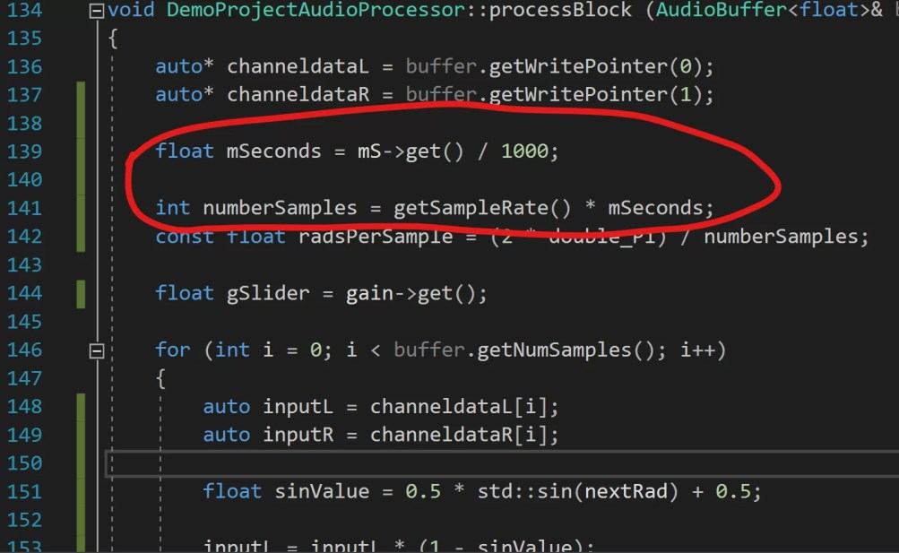
Changing the LFO
Add new audio parameter float to change how often audio pans between L & R.
I called it mS and set range to 10 – 5000.
Now add this to process block
float mSeconds = mS->get() / 1000;
//Replace this //const int numberSamples = getSampleRate();
//With this int numberSamples = getSampleRate() * mSeconds;
This finds value of mS slider and divides it by 1000, to find value in seconds, then multiplies this with sample rate
Make sure to remove the const from the numberSamples variable.
Build plugin, and you can use the mS slider to change the autopanner rate

Slide 8
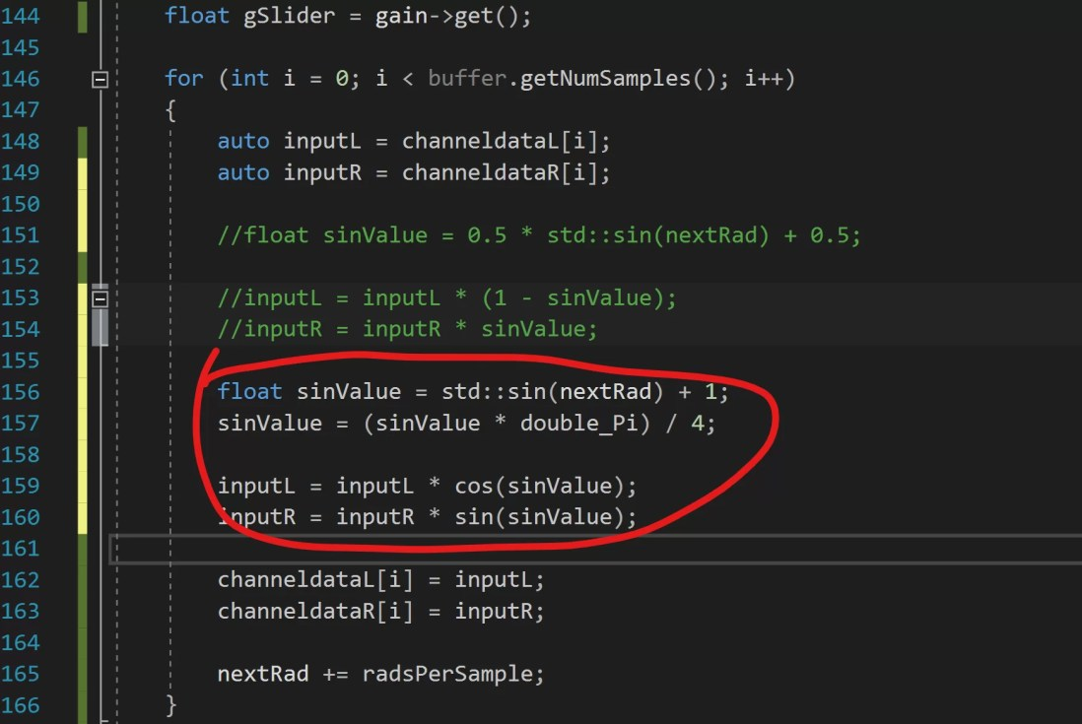
Constant power panning
//Replace This
//float sinValue = 0.5 * std::sin(nextRad) + 0.5; //1
//inputL = inputL * (1 – sinValue); //2
//inputR = inputR * sinValue;
//With This
float sinValue = ::sin(nextRad) + 1;
sinValue = (sinValue * double_Pi) / 4;
inputL = inputL * cos(sinValue);
inputR = inputR * sin(sinValue);
You should hear a smoother transition between the left and right channels.
If you make mS very small you should hear some amplitude modulation effects.

